Slide 1
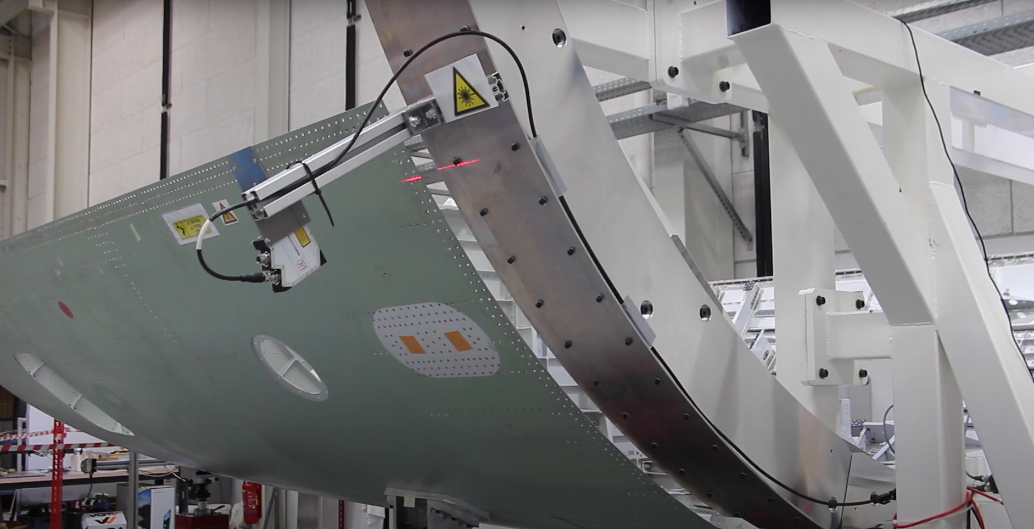




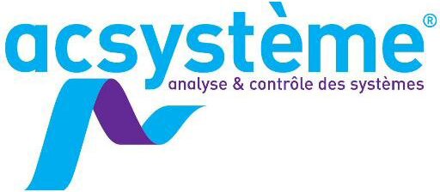








COMPLETED PROJECT
HAPPY PROJECT| 2018 - 2021
The aim of the project is to develop and evaluate an aerostructure assembly line concept that is flexible with regard to product variants and rate variations. The proposed system consists of lightweight, flexible positioners, mounted on mobile bases, driven by a continuous servo-control system, based on local or global measurements to take account of the flexibility of parts and tooling.
3 YRS
HANDLING & POSITIONING OF HEAVY PARTS
OF ASSEMBLY
2 485 K€
PROJECT ACHIEVEMENTS
Development of a control law that compensates for the flexibility
of parts and tooling based on local measurements in 2 use cases
use cases:
- Using cameras on the tenon / clevis use case
- Using laser profilometers for the orbital joint.
Adaptation of the control law to control the unscrewing of a part
from a global metrology system.
INDUSTRIAL APPLICATIONS
The demonstrator resulting from the ‘HAPPY’ project has been transferred to the AIRBUS ATLANTIC site at Montoir de Bretagne (44) for performance evaluation in real conditions. At the same time, a follow-up HAPPY2 project was launched in August 2022 to mature this technology with more complex aeronautical applications and the integration of a use case in the naval sector:
The docking of shells prior to welding for the manufacture of nuclear boilers
Wing/fuselage junction in aeronautics
Assembly of the ventral beam on the central box
TECHNICAL & ECONOMIC IMPACTS
∙ The proposed solution is lightweight and modular, and meets the clean shopfloor requirements of the aerospace industry.
∙ Assembly times using this concept are around 10 times faster than those currently used in the aerospace industry.
Notes:
Avec image

